Slide 1
Machine Learning for Humans
A 101 guide

Slide 2
/me
Technical Consultant as day job
Mozilla Techspeaker and contributor
Studies Data Science and Business Analytics in Indian School of Business
from India
a Father , Husband and travel freak ☺

Slide 3
Aim
To build machine learning awareness among masses.
get people to be involved and not think it’s rocket science
to help hischoolers and other stream folks to learn and understand the tremendous fun and potential of it.

Slide 4
Machine Learning
What
Why
How
When

Slide 5
Types
Supervised Learning
Unsupervised Learning
Semi Supervised Learning
Reinforcement Learning

Slide 6
Supervised Learning
Map between features and labels
Train a set of labeled data and then predict the outcome of a unlabeled.
Feature sets of both training and unlabeled data should be same.

Slide 7
Unlabeled data
Web pages
LinkedIN profiles
Youtube videos
Emails
Gene sequences

Slide 8
Labeled data
Web pages – Spam / Not Spam
LinkedIN profiles - Get a job / Not
Youtube videos - Animation / Not an animation
Emails - Primary / Promotion / Updates / Forum
Gene sequences - Traces of Cancer / Not

Slide 9
Break up
Regression
Used for numerical value prediction
Classification
Used for categorical class prediction
Recommendation
Predict preferences from large pool of options
Retrieval
Predict entity or object based on query.

Slide 10
map:{real world}
Regression
Forecasting weather, stock markets
Classification
Spam detection, gene sequencing (cancer / not)
Recommendation
Netflix, Amazon, Youtube
Retrieval
Search Results

Slide 11
Classification
Decision Trees
Nearest Neighbors
Support Vector Machines Classifier
Artificial Neural Networks

Slide 12
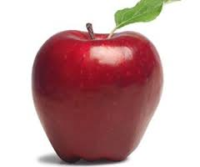
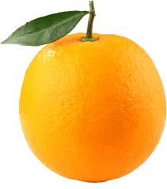
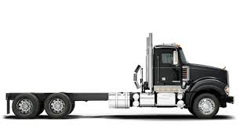
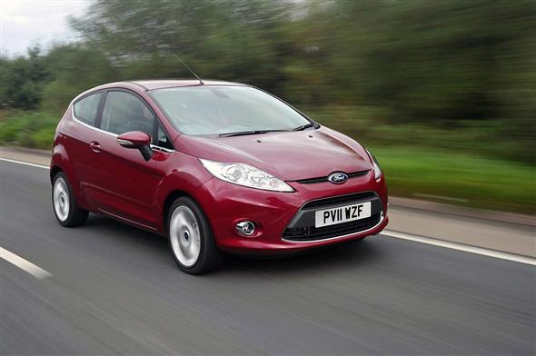

Slide 13
6 lines to ML

Slide 14
Iris Dataset

Slide 15
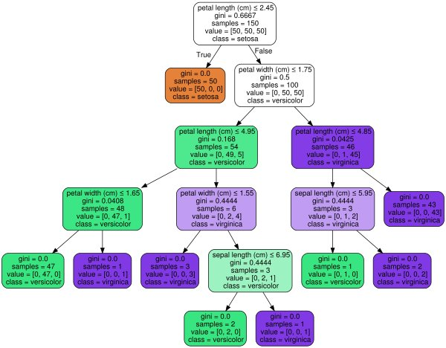
Decision Trees

Slide 16
Visual Decision Trees
r2d3

Slide 17
K Nearest Neighbor
Euclidian distance
More than two dimensions
Determining K

Slide 18
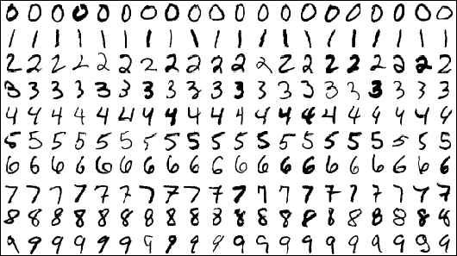
MNIST

Slide 19
LIVE demoes Online

Slide 20
Q/A

